Slide 1
An Introduction to MongoDB
By Noah Constable, Biruk Mengistu, and Kyle Day

Slide 2
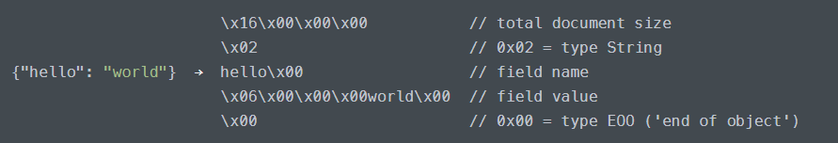
Background
BSON
Binary JSON
Additional data types
Binary
Regex
Arrays
Better speed, worse storage
Length, index prefixes
NoSQL (Not Only SQL)
Documents
Schemaless

Slide 3
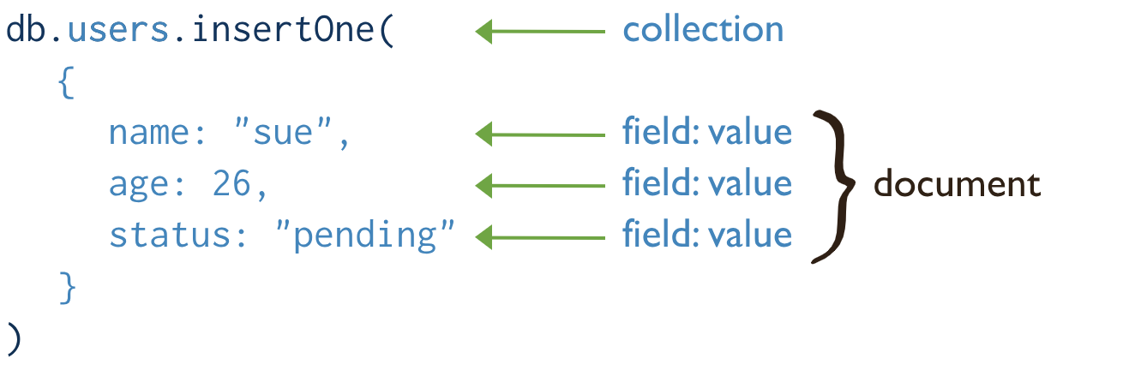
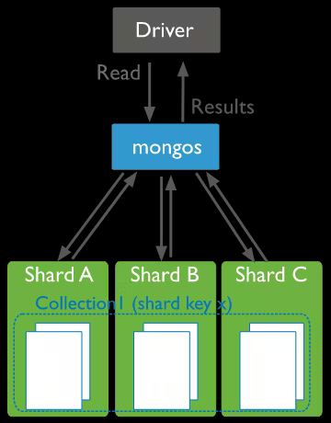
Key Features
Document-Oriented
Varying data structures
Scalable and Distributed
Horizontal scaling
Split storage
Performance
Fault tolerance
Sharding
Performance
Optimized for read/write
BSON
Caching
Flexible Data Models
NoSQL

Slide 4
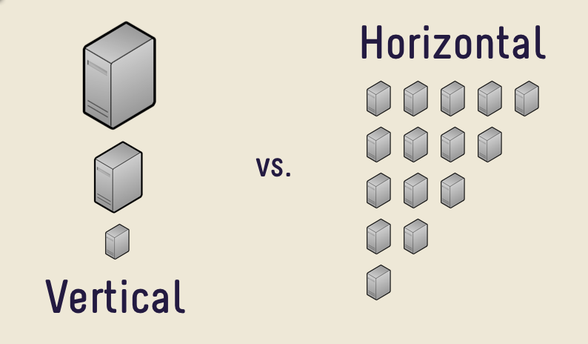

Slide 5
Key Features
Document-Oriented
Varying data structures
Scalable and Distributed
Horizontal scaling
Split storage
Performance
Fault tolerance
Sharding
Performance
Optimized for read/write
BSON
Caching
Flexible Data Models
NoSQL

Slide 6
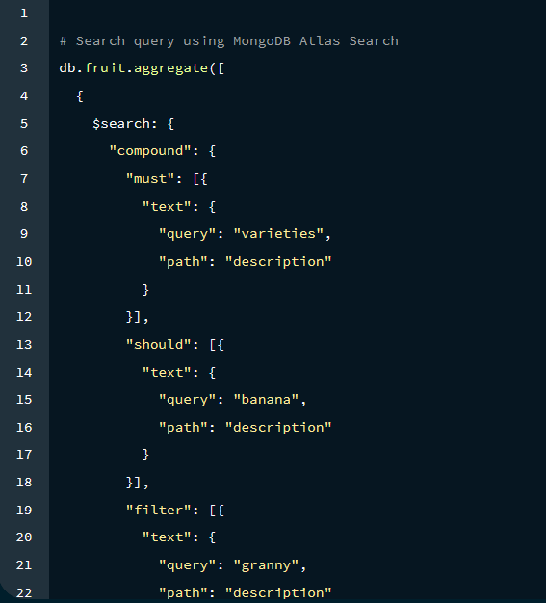
Key Features cont.
4. MongoDB Query Language
Complex operations
Queries
Aggregations
Joins
Data Analysis
5. Security
Auth
RBAC
SSL
Audit Logs

Slide 7
In Layman’s Terms
Rephrase and summarize, if you have an application that is not:
Handling transactional data
Performing complex operations
Very dependent on consistent data types and schemas
then Mongo might not be your solution!
Mongo:
Scales better
Is much more flexible with data types
Outperforms for simpler operations

Slide 8
MongoDB Architecture
Notes:
Hello everyone, my name is Biruk Mengistu and I will be talking about the architecture and use cases for MongoDB

Slide 9
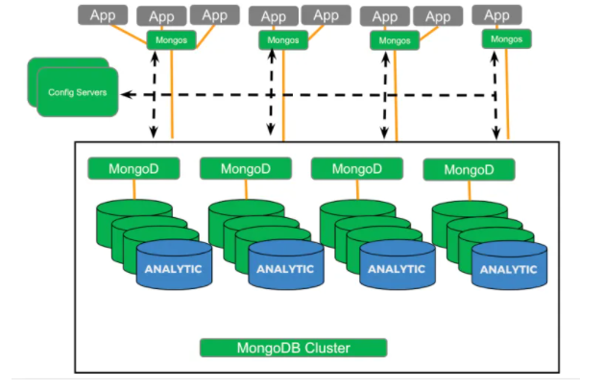
Components of the MongoDB Architecture
Primary Nodes (mongos)
Secondary Nodes
Sharding
Load Balancing
Config Servers
Analytic Nodes
Notes:
So, The MongoDB architecture consists of several components that work together to provide a highly available, scalable, and fault-tolerant database system. I will be talking about a couple of them to give an overview of how everything works together, These components include primary nodes, secondary nodes, sharding, load balancing, config servers, and analytic nodes.

Slide 10
Components of the MongoDB Architecture
Primary Nodes (mongos)
Act as a query router
Handle load balancing
Route client requests to the appropriate shard based on the shard key
Ensures high availability and fault tolerance
Notes:
Let's start with primary nodes, also known as mongos. These nodes act as a query router and handle load balancing in the MongoDB cluster. When a client sends a request to the cluster, the primary node routes the request to the appropriate shard based on the shard key, which we will talk about in just a second. Primary nodes also ensure high availability and fault tolerance in the cluster. If a primary node fails, one of the secondary nodes is automatically promoted to primary to maintain the availability of the system.

Slide 11
Components of the MongoDB Architecture
Sharding
Technique used to horizontally partition data across multiple servers or nodes
Data is divided into smaller, more manageable chunks called shards
Sharding allows for distributing data and workload across multiple nodes, providing better scalability and performance
Notes:
Sharding is a technique used to horizontally partition data across multiple servers or nodes. Data is divided into smaller, more manageable chunks called shards. A shard key is a unique identifier for a piece of data in the cluster. It is used to determine which shard the data belongs to and where it should be stored. By using a shard key, MongoDB ensures that data is evenly distributed across the cluster and provides efficient querying of data and allows the cluster to handle large volumes of data by splitting it across multiple nodes. So in this example on the right, if we consider the shard key to be someones name in the database, names starting with A would go into shard A and and so on.

Slide 12
Components of the MongoDB Architecture
Secondary Nodes
Used for redundancy and high availability
Replicate data from primary nodes
Provide read access to clients
Can be promoted to primary in the event of a primary node failure
Notes:
As mentioned earlier, Secondary nodes provide redundancy and high availability to the MongoDB cluster. They periodically replicate data from the primary node and allow clients to read data. If the primary node goes down, one of the secondary nodes automatically steps up to take its place, ensuring the cluster remains available.

Slide 13
Components of the MongoDB Architecture
Config Server
Stores metadata and configuration information for the entire cluster
Keeps track of the cluster topology, shard key ranges, and other configuration details
Notes:
Config servers are like the brain of the MongoDB cluster. They store important metadata and configuration information for the entire cluster, such as the cluster topology, shard key ranges, and other configuration details. Think of them as the information center that keeps the cluster running smoothly.

Slide 14
Components of the MongoDB Architecture
Analytic Nodes
Stores metadata and configuration information for the entire cluster
Keeps track of the cluster topology, shard key ranges, and other configuration details
Notes:
Analytic nodes are specialized nodes in the MongoDB cluster that are optimized for processing large volumes of data. They are used for running complex queries, analytics, and reporting on the data in the cluster. Analytic nodes have more memory and CPU resources than other nodes in the cluster to handle the increased workload.
Because analytic nodes have such a high workload, they are usually deployed separately from other nodes in the cluster to operate independently and efficiently, without affecting the performance of other nodes. Configuring them correctly requires careful planning and monitoring to ensure optimal performance. Overall, analytic nodes are essential for organizations that need to analyze large amounts of data quickly and efficiently.

Slide 15
CRUD Guide

Slide 16
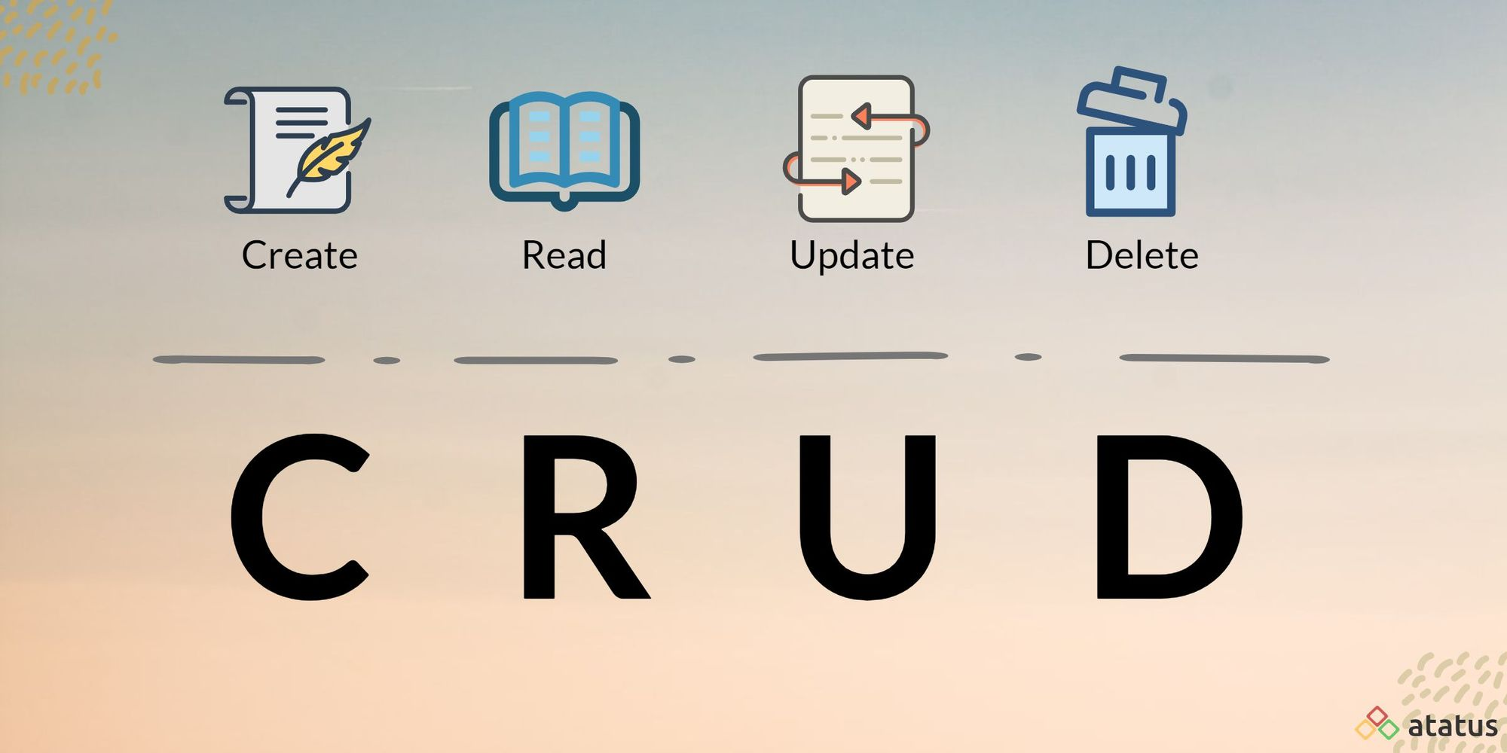
CRUD Overview

Slide 17
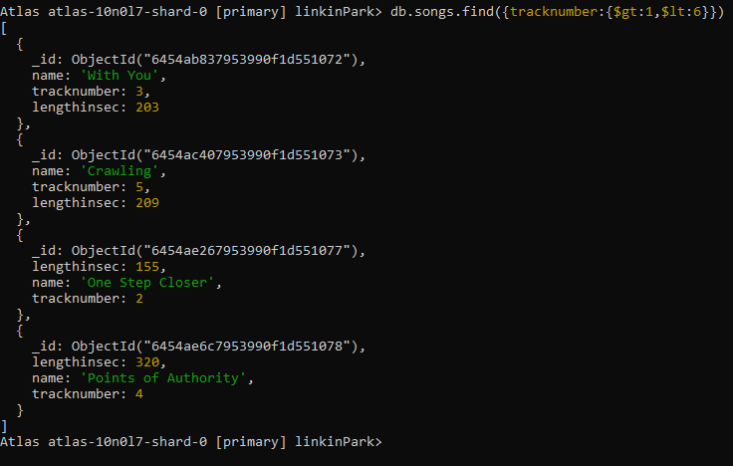
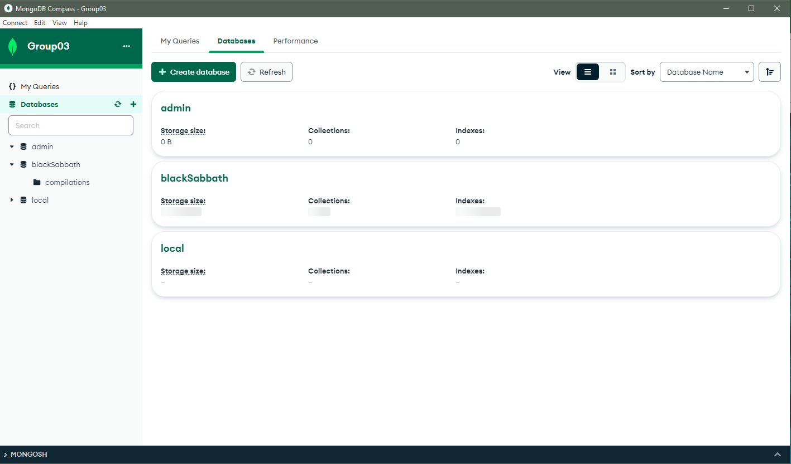

CRUD Overview
CRUD operations can be performed in:
MongoDB Compass (GUI)
MongoShell or Atlas (CLI)
Several IDEs (e.g., VSCode via the MongoDB extension)

Slide 18
Rules for Creating Databases and Collections
All databases require at least one collection
Collections have mutually exclusive types:
Time-series collections allow for sorting via time
Capped collections limit the collection’s size
Clustered collections are used for optimizing performance
String rules (e.g., locale, alternate, backwards, etc.) can be enforced through custom collation

Slide 19
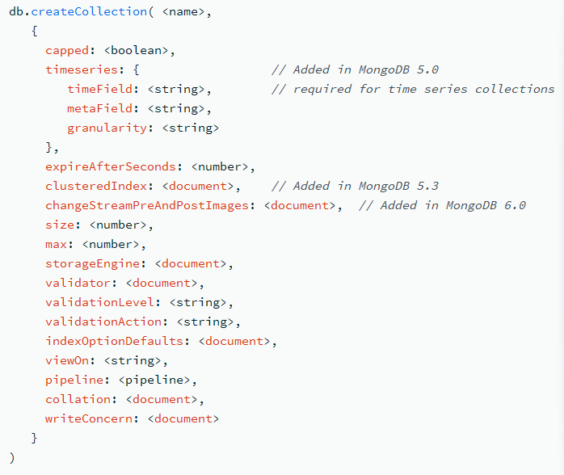
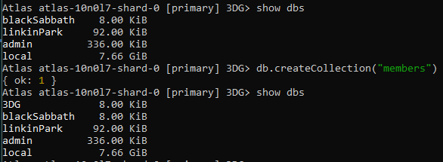
Creating Databases and Collections - Atlas
Creating a database is as simple as using use <name> (disappears in the shell)
Creating a collection can be simple or complex
Just a name
A name and several options
Several options are documents

Slide 20
Overview for Creating Documents
Inserted manually if via CLI
Each document has a unique object identifier
OID permits references like SQL keys

Slide 21
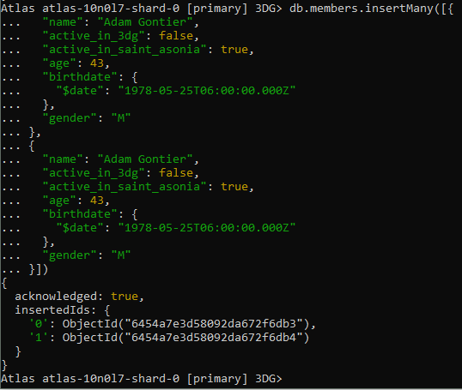
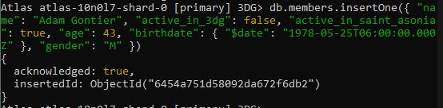
Creating Documents - Atlas
There are two insertion commands:
db.<collectionname>.insertOne(<document>)
db.<collectionname>.insertMany([<document>, …])
The console generally will generate an OID

Slide 22
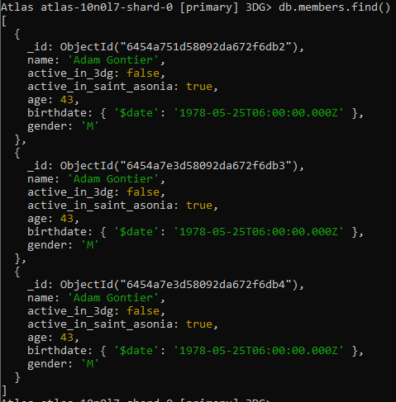
Reading Documents
db.<collectionname>.find() can be used to find all documents in a collection
Documents are listed in order of creation

Slide 23
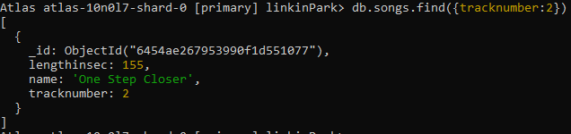
Reading Documents
Parameters may be used to narrow down searches (like select in SQL)
db.<collectionname>.find(<filter>)

Slide 24
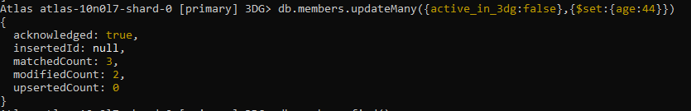
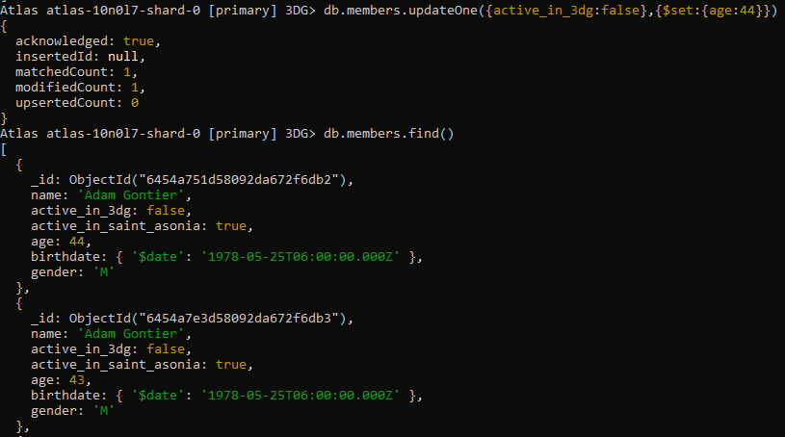
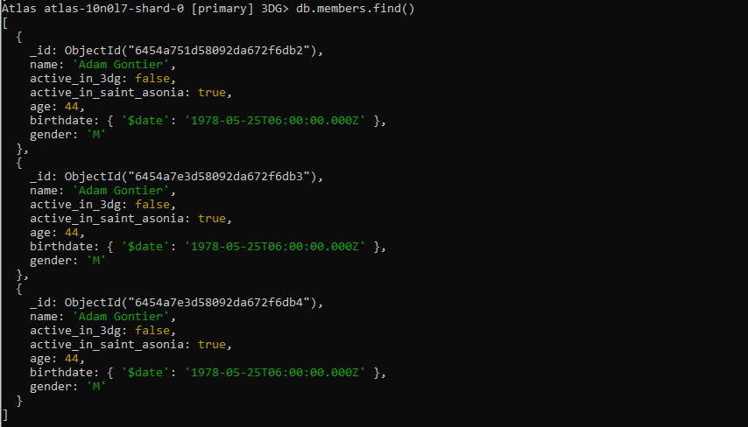
Updating Documents
There are two update methods for documents:
db.collection.updateOne(<filter>, <change>)
db.collection.updateMany(<filter>, <change>)

Slide 25
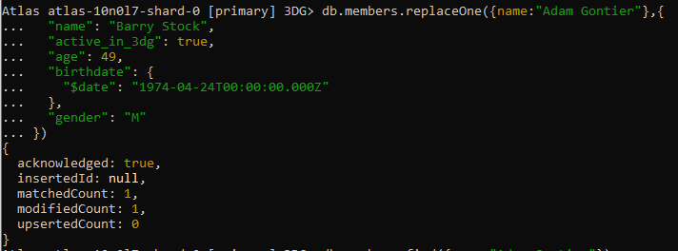
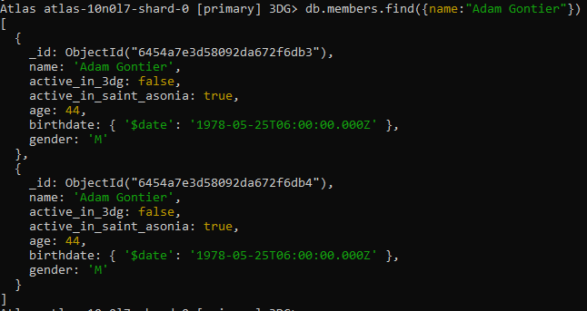
Updating Documents
db.collection.replaceOne(<filter>, <document>) replaces one document with another

Slide 26
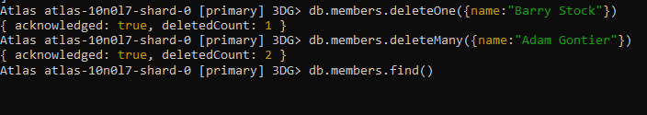
Deleting Documents
There are two deletion methods:
db.<collection_name>.deleteOne(<filter>)
db.<collection_name>.deleteMany(<filter>)

Slide 27
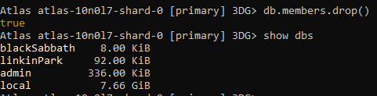
Deleting Collections
The method to delete collections is db.<collection_name>.drop()
If the only collection in a database is dropped, the database will be dropped as well

Slide 28
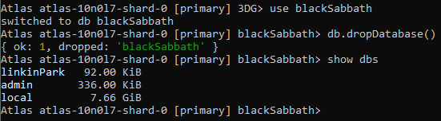
Deleting Databases
Databases can be deleted via db.dropDatabase()

Slide 29
Compatibility and Integration

Slide 30
Compatibility
MongoDB is used with various programming languages
Java
Typescript
Many more
Several frameworks are also compatible
Angular
Django
Many more

Slide 31
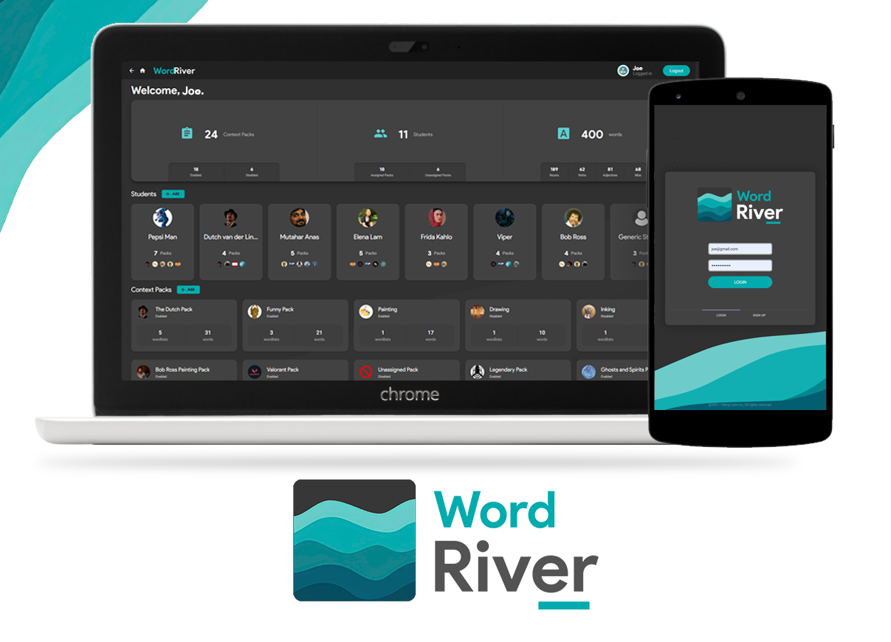
Example: WordRiver from Software Design
WordRiver is an Angular, Java, and Typescript-based application
It groups word lists based on subject matter and lets teachers/parents assign them to students

Slide 32
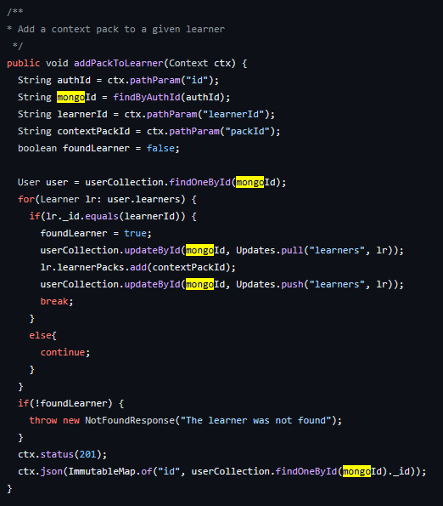
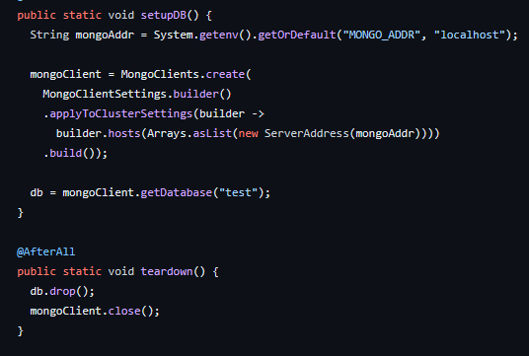
Example: WordRiver from Software Design
MongoDB is used extensively as a database

